Slide 1

Green Pace
Security Policy Presentation
Developer: Jordan Purdy

Slide 2

OVERVIEW: DEFENSE IN DEPTH
Purpose of the Policy
Standardize
Reduce attack surface
Assume vulnerabilities at any layer
Apply multiple controls
Integrate security through DevSecOps
Defense in Depth (DiD)
Prevention
Detection
Response
Continuous Improvement

Slide 3
THREATS MATRIX
Priority is based on
Severity
Likelihood
Remediation Cost
Potential impact
Likely STD- 002-CPP – Data Value STD-003-CPP – String Correctness STD-008-CPP – Integer Arithmetic STD-010-CPP – File handling | Priority STD-004-CPP - SQL Injection STD-005-CPP – Memory Protection STD-009-CPP – Pointer Safety
Low priority STD-006-CPP – Assertions STD-007-CPP - Exceptions | Unlikely STD-001-CPP – Data Type

Slide 4
10 PRINCIPLES
Validate Input Data — STD-002, 003, 004, 006, 008, 009, 010
Heed Compiler Warnings — STD-001, 008
Architect and Design for Security — STD-004, 005, 010
Keep It Simple — STD-003, 005, 006, 007, 009
Default Deny — STD-004, 010
Least Privilege — STD-010
Sanitize Data Sent to Other Systems — STD-004, 010
Practice Defense in Depth — STD-002 through STD-010
Use Effective QA Techniques — STD-001, 002, 005, 006, 007, 008, 009
Adopt a Secure Coding Standard — All ten standards

Slide 5
CODING STANDARDS
Priority 5
STD-004-CPP — SQL Injection
STD-005-CPP — Memory Protection
STD-009-CPP — Pointer Safety
Priority 4
STD-003-CPP — String Correctness STD-008-CPP — Integer Arithmetic STD-002-CPP — Data Value STD-010-CPP — File Handling
Priority 3
STD-006-CPP — Assertions STD-007-CPP — Exceptions
Priority 2
STD-001-CPP — Data Type
Ranking considers severity, likelihood, cost to fix, and impact on confidentiality, integrity, and availability

Slide 6
ENCRYPTION POLICIES
Encryption at Rest
Encrypt databases, files, backups, and persistent sensitive data
Protect encryption keys separately
Encryption in Flight
Encrypt communication between clients, APIs, and services
Reject insecure connections
Encryption in Use
Minimize plaintext exposure in memory
Limit process and user access
Remove secrets when no longer required

Slide 7
TRIPLE-A POLICIES
Authentication — Who are you?
Unique identities
Secure login
MFA for sensitive access
Authorization — What may you do?
Role-based access
Least privilege
Default deny
Accounting — What did you do?
Logins
Database changes
User creation and privilege changes
Sensitive file access

Slide 8
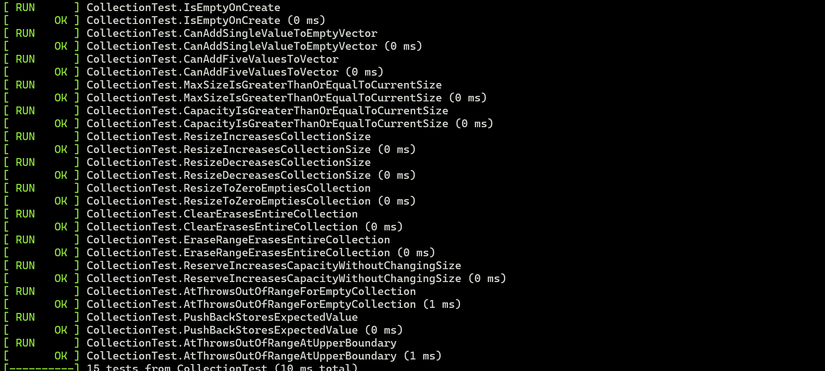
Can a Value Be Added to an Empty Vector?
Test: CanAddSingleValueToEmptyVector
Type: Positive Test
Confirms the vector begins empty
Adds one entry
Verifies size changes from 0 to 1
Verifies the collection is no longer empty
TEST_F(CollectionTest, CanAddSingleValueToEmptyVector)
{
ASSERT_TRUE(collection->empty());
ASSERT_EQ(collection->size(), 0);
add_entries(1);
EXPECT_FALSE(collection->empty());
EXPECT_EQ(collection->size(), 1);
}

Slide 9
Can the Vector Safely Resize to a Larger Size?
Test: ResizeIncreasesCollectionSize
Type: Positive Test
Starts with 5 elements
Resizes collection to 10
Confirms final size equals 10
Confirms the vector remains valid and nonempt
TEST_F(CollectionTest, ResizeIncreasesCollectionSize)
{
add_entries(5);
ASSERT_EQ(collection->size(), 5);
collection->resize(10);
EXPECT_EQ(collection->size(), 10);
EXPECT_FALSE(collection->empty());
}

Slide 10
Does Clear Remove All Elements from the Vector?
Test: ClearErasesEntireCollection
Type: Positive Test
Adds 5 elements
Calls clear()
Confirms empty() returns true
Confirms size equals 0
TEST_F(CollectionTest, ClearErasesEntireCollection)
{
add_entries(5);
ASSERT_EQ(collection->size(), 5);
collection->clear();
EXPECT_TRUE(collection->empty());
EXPECT_EQ(collection->size(), 0);
}

Slide 11
Does an Invalid Index Throw an Exception on an Empty Vector?
Test: AtThrowsOutOfRangeForEmptyCollection
Type: Negative Test
Collection contains no elements
Attempts collection->at(0)
Expected result: std::out_of_range
Test passes only if the exception occurs
TEST_F(CollectionTest, AtThrowsOutOfRangeForEmptyCollection)
{
ASSERT_TRUE(collection->empty());
EXPECT_THROW(collection->at(0), std::out_of_range);
}

Slide 12
Does Accessing Past the Upper Boundary Throw an Exception?
Test: AtThrowsOutOfRangeAtUpperBoundary
Type: Negative / Boundary Test
Creates a vector with 5 elements
Valid indexes are 0–4
Attempts access at collection->size()
Expected result: std::out_of_range
TEST_F(CollectionTest, AtThrowsOutOfRangeAtUpperBoundary)
{
add_entries(5);
ASSERT_EQ(collection->size(), 5);
EXPECT_THROW(collection->at(collection->size()), std::out_of_range);
}

Slide 13

AUTOMATION SUMMARY

Slide 14
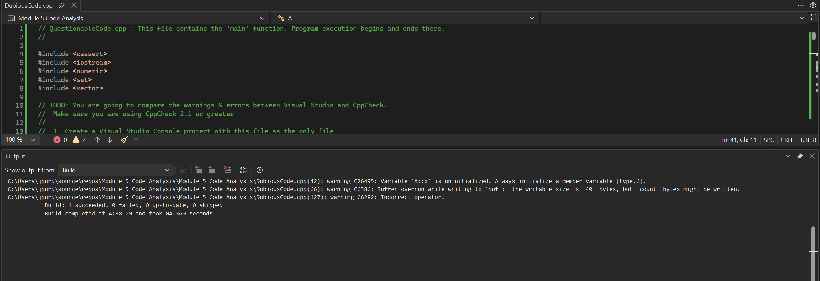
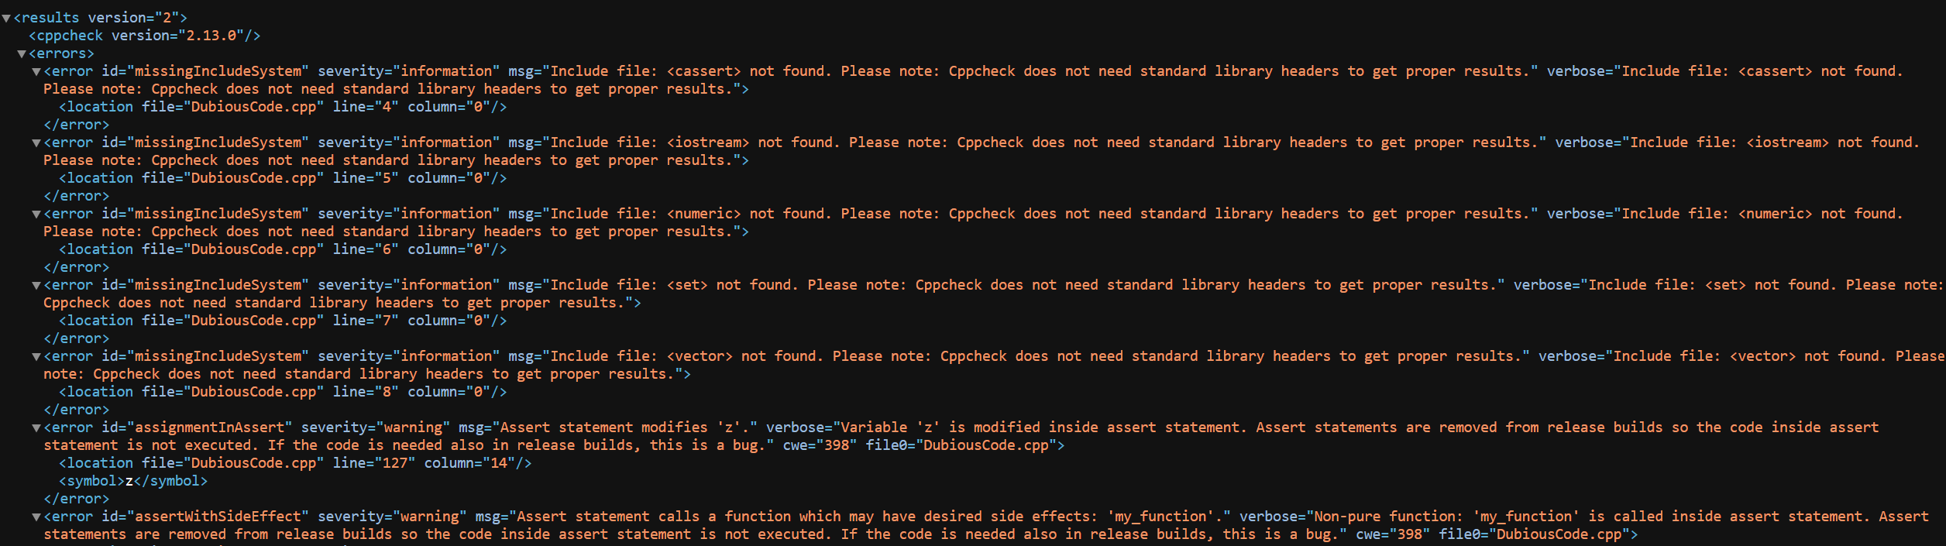
TOOLS
CodeQL
Security-focused static analysis
Queries code for vulnerability patterns
Google Test
Positive, negative, and boundary unit tests
Fuzz Testing
Sends abnormal inputs automatically
Visual Studio Code Analysis
Compiler/static warnings
Fast developer feedback
Cppcheck
Independent C/C++ static analysis
Finds correctness, memory, and style defects

Slide 15
RISKS AND BENEFITS
Problem
Existing vulnerabilities and technical debt
Inconsistent developer practices
Security discovered too late
Act Now
Lower remediation cost
Reduced breach likelihood
Better audit readiness
Consistent secure development
Wait
Greater technical debt
Larger attack surface
Higher remediation cost
Greater operational and reputational impact
Limitation
Automated tools can produce false positives and miss business-logic flaws

Slide 16
RECOMMENDATIONS
Current Policy Gaps
Software dependency and supply-chain scanning
Secrets management
Software Bill of Materials (SBOM)
Formal fuzz-testing requirements
Security metrics and remediation deadlines
More explicit incident-response testing
Recommended Improvements
Add automated SCA to CI/CD
Centralize credentials and keys
Track vulnerabilities by severity
Review policy after incidents and major system changes
Security should be continuous, not a final release step

Slide 17
CONCLUSIONS
Standards to Maintain / Adopt
SEI CERT C++ Coding Standard
NIST Secure Software Development Framework
OWASP application-security guidance
CWE vulnerability classifications
Green Pace internal secure coding requirements
Future Direction
Security from design through production
Automated enforcement
Continuous testing
Annual and incident-driven policy review
Assume vulnerabilities and maintain layered defenses

Slide 18
REFERENCES
Souppaya, M., Scarfone, K., & Dodson, D. (2022). Secure software development framework (SSDF) version 1.1. NIST Special Publication 800-218, 1(1). https://doi.org/10.6028/nist.sp.800-218
SEI CERT C++ Coding Standard | CERT Secure Coding. (2016). In Github.io. https://cmu-sei.github.io/secure-coding-standards/sei-cert-cpp-coding-standard/
GoogleTest Primer. (n.d.). In GoogleTest. Retrieved August 16, 2026, from https://google.github.io/googletest/primer.html
CodeQL query help — CodeQL query help documentation. (2026). Github.Com. https://codeql.github.com/codeql-query-help/
TylerMSFT. (2026, January 15). Configure code analysis and error list options for C and C++ - Visual Studio (Windows). MicrosoftLearn. https://learn.microsoft.com/en-us/visualstudio/ide/configure-c-cpp-advanced-options?view=visualstudio

